Slide 1
August 2025 Ground Water Sampling Results

Slide 2
Sampling Background
Sampling began 8/14, ended 8/28 2025
80 samples were collected across 66 landowners from various sources.
Every sample had a reportable level of at least one contaminant

Slide 3
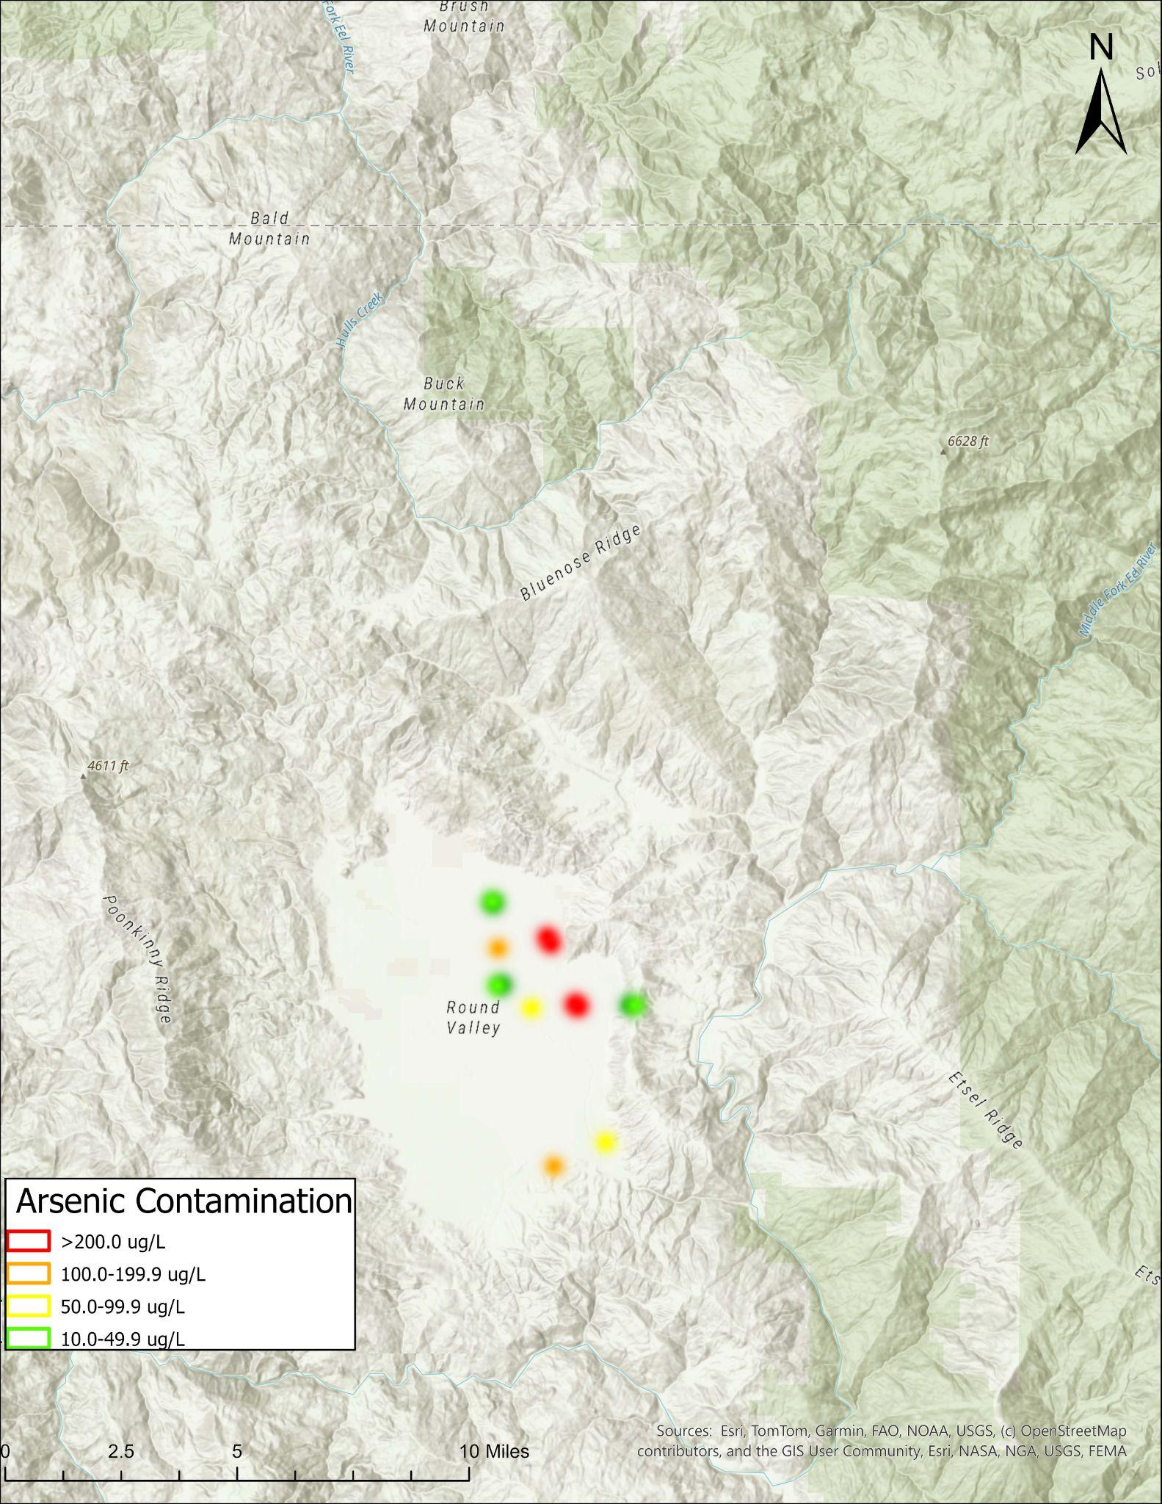
Arsenic
30/80 samples (38%) contained greater than 2 µg/L of arsenic
Of those 30, 17 had an arsenic level above the EPA limit (10 µg/L)
Arsenic levels ranged from 2.4 µg/L to 260 µg/L

Slide 4
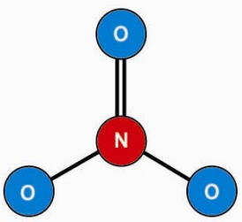
Nitrates
30/80 samples (38%) contained greater than 0.4 mg/L of nitrates
Of those 30, 5 had a nitrate level above the EPA limit (3 mg/L)
Nitrate levels ranged from .54 mg/L to 4.9 mg/L
Image from https://waterquality.montana.edu

Slide 5
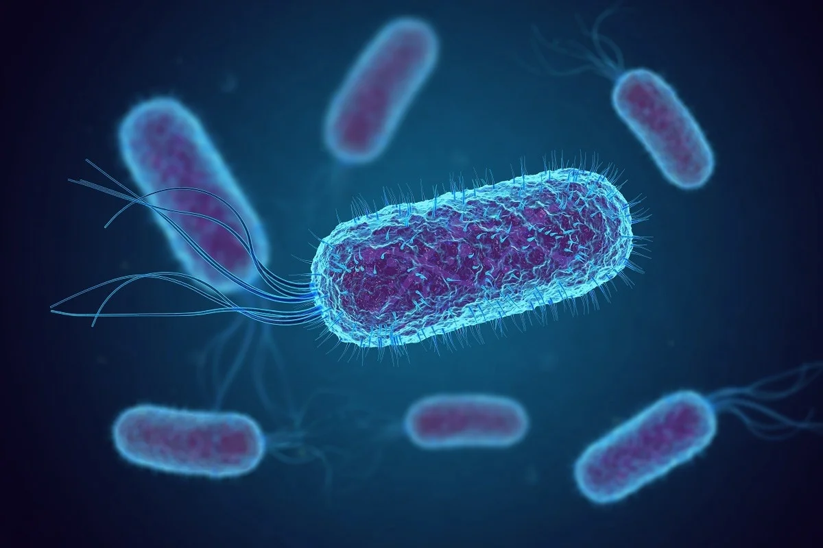
Total Coliforms and E.Coli
36/80 samples (45%) contained coliforms
Of those 36, 4 contained E. Coli
Total coliform levels ranged from 1 per 100 mL to >2419.6 per 100mL
E. Coli levels ranged from 1 per 100 mL to 4.1 per 100 mL
Image from https://harpethconservancy.org

Slide 6
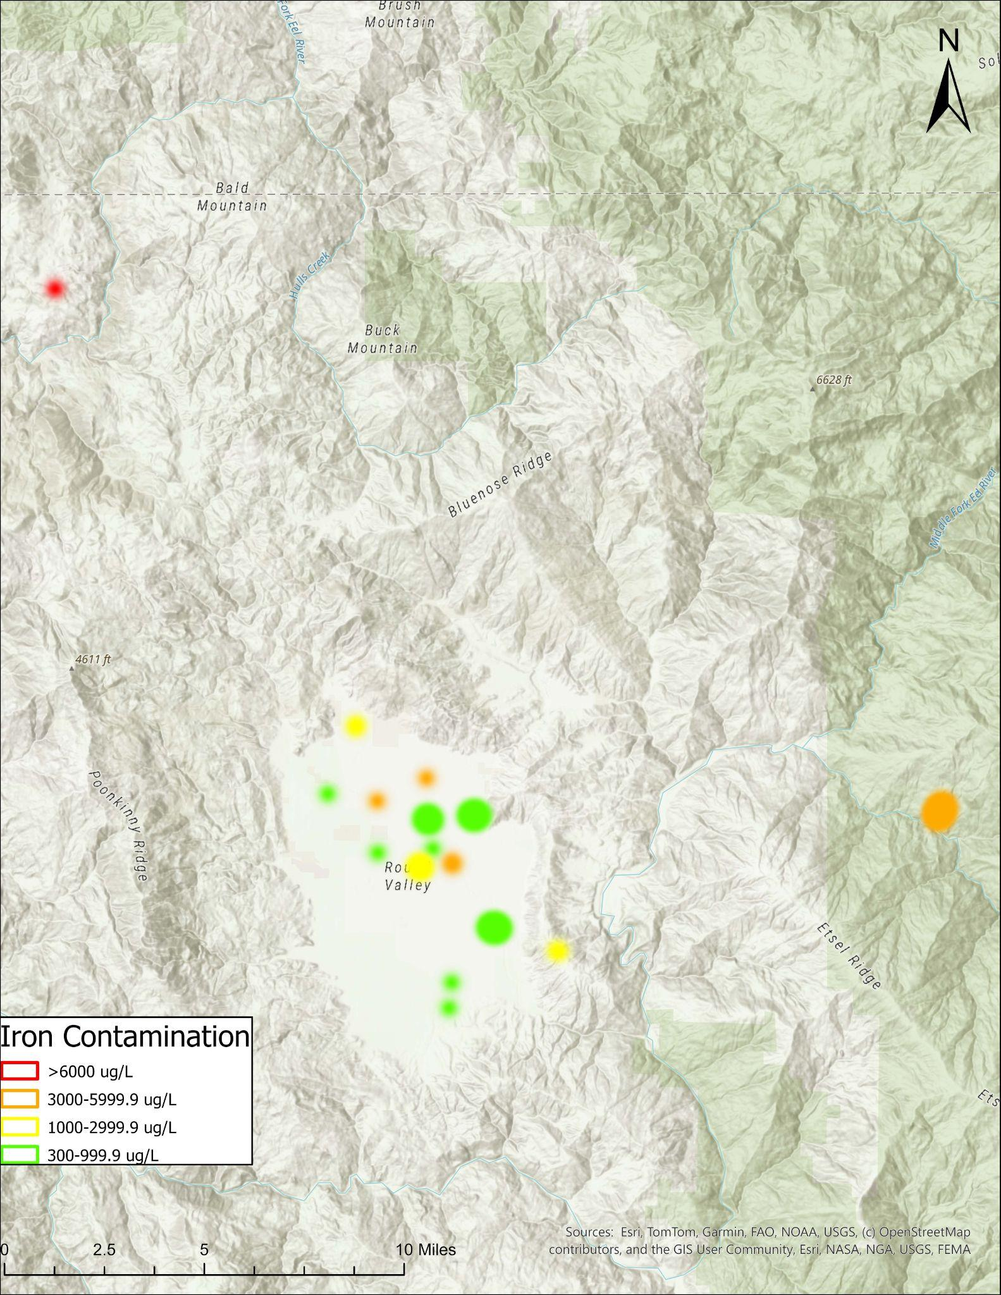
Iron
35/80 samples (44%) contained greater than 100 µg/L of iron
Of those 35, 22 had an iron level above the EPA limit (300 µg/L)
Iron levels ranged from 130 µg/L to 6500 µg/L

Slide 7
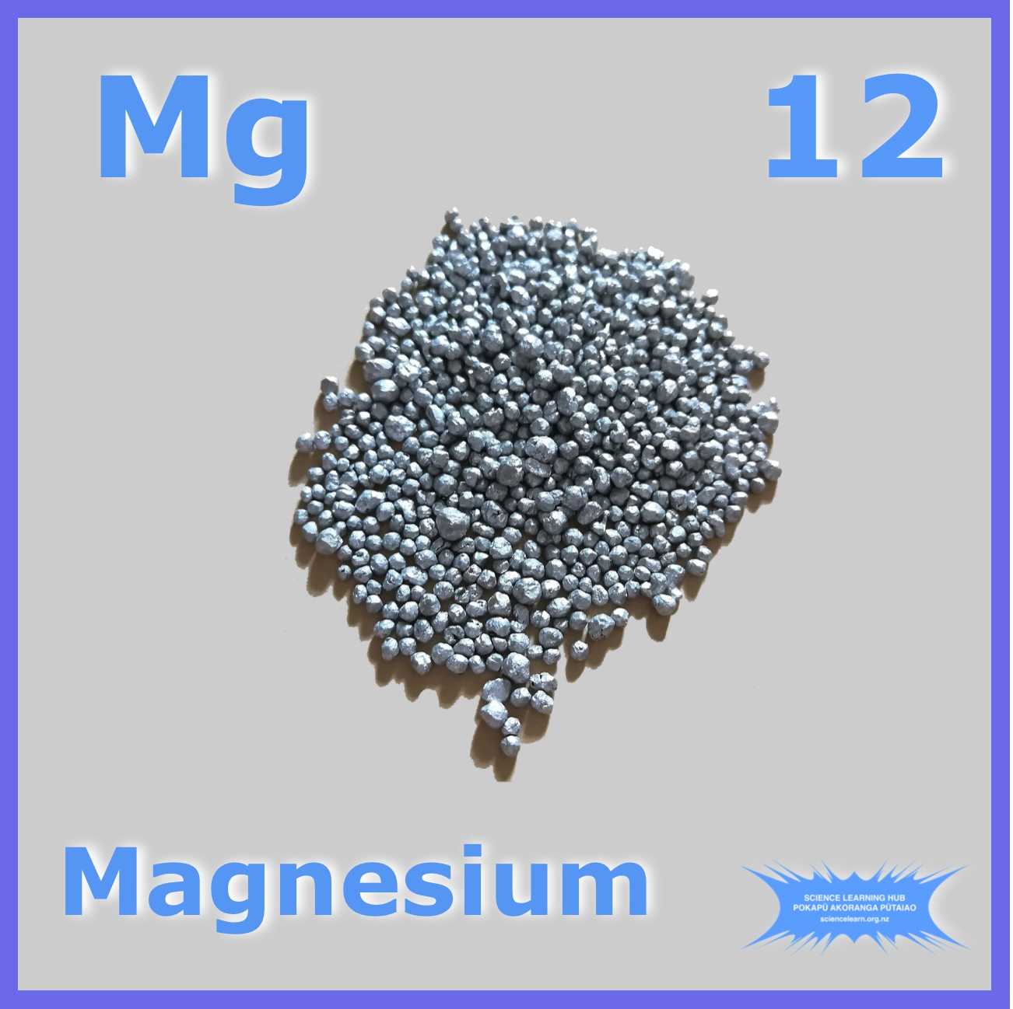
Magnesium
77/80 samples (96%) contained greater than 0.6 mg/L of magnesium
There is no EPA recognized unsafe level for magnesium
Magnesium levels ranged from .69 mg/L to 55 mg/L
Image from https://www.sciencelearn.org.nz

Slide 8
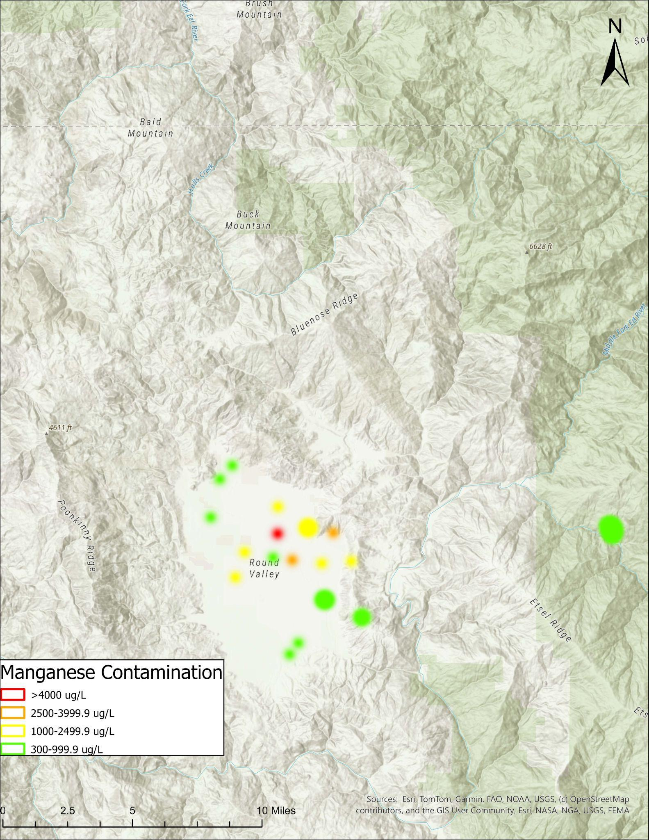
Manganese
44/80 samples (55%) contained greater than 20 µg/L of manganese
Of those 44, 24 had a manganese level above the EPA limit (300 µg/L)
Manganese levels ranged from 20 µg/L to 4500 µg/L

Slide 9
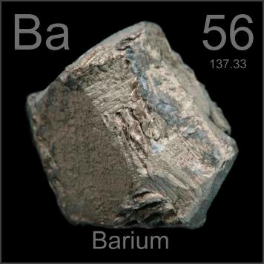
Barium
74/80 samples (93%) contained greater than 0.01 mg/L of barium
Of those 74, 0 had a barium level above the EPA limit (2 mg/L)
Barium levels ranged from .014 mg/L to .7 mg/L
Image from https://periodictable.com

Slide 10
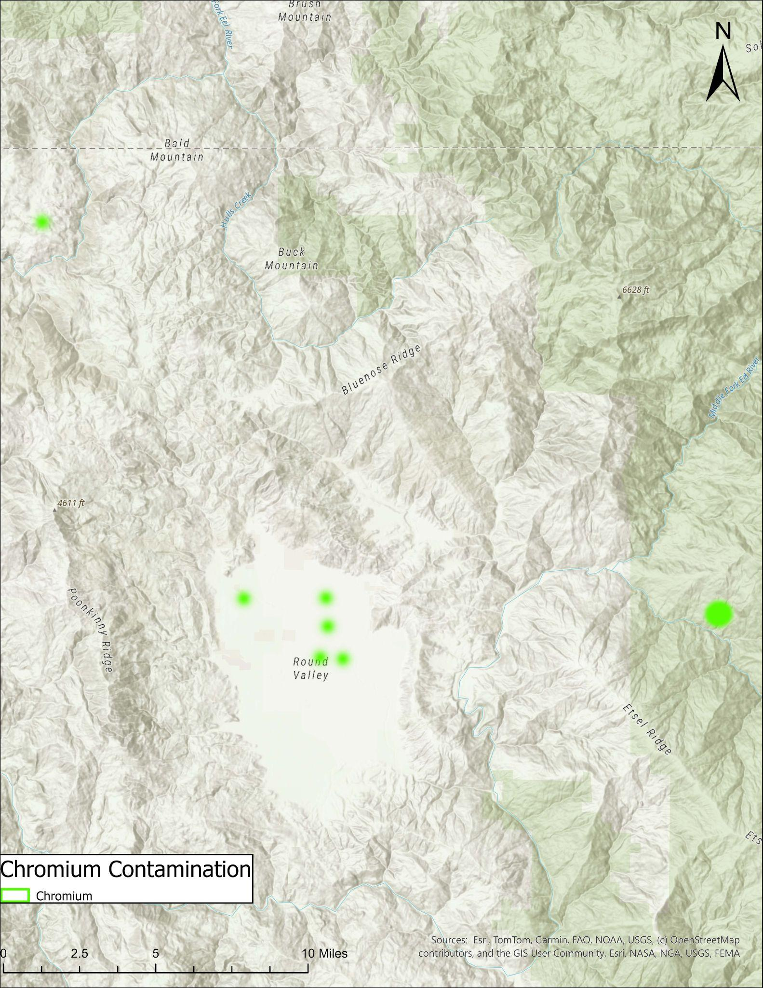
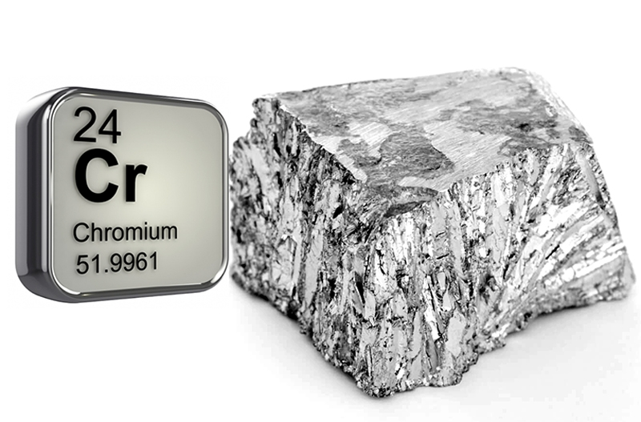
Chromium
7/80 samples (9%) contained greater than 0.002 mg/L of chromium
Of those 7, 0 had a chromium level above the EPA limit (.01 mg/L)
Chromium levels ranged from .0024 mg/L to .0089 mg/L
Image from https://www.sportsperformancebulletin.com

Slide 11
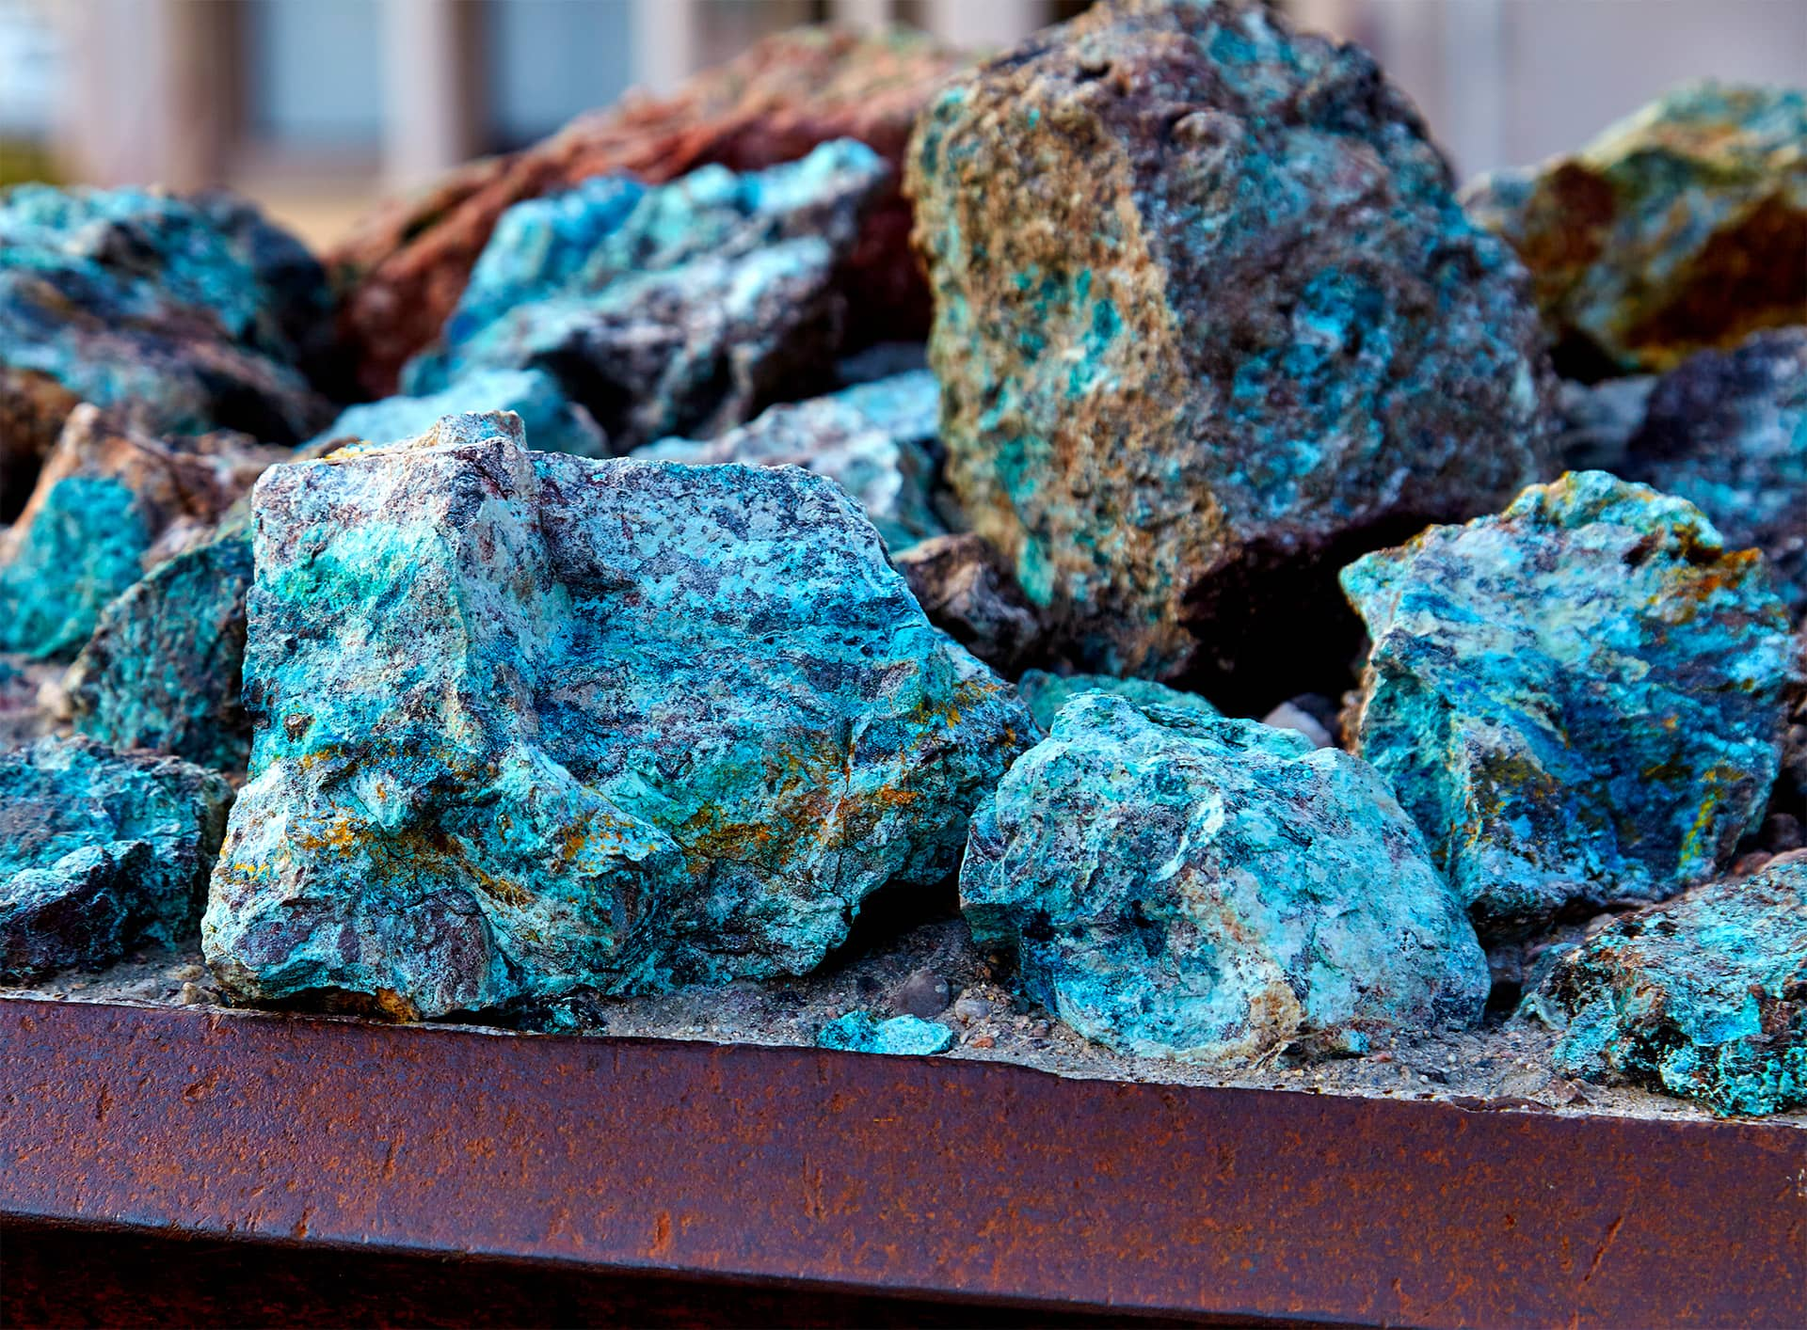
Cobalt
2/80 samples (3%) contained greater than 0.002 mg/L of cobalt
There is no EPA recognized unsafe level for cobalt
Cobalt levels ranged from .0024 mg/L to .0056 mg/L
Image from https://www.cobaltinstitute.org

Slide 12
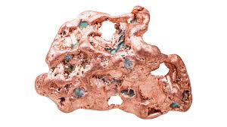
Copper
67/80 samples (84%) contained greater than 0.002 mg/L of copper
Of those 67, 0 had a copper level above the EPA limit (1.3 mg/L)
Copper levels ranged from .0021 mg/L to 1 mg/L
Image from https://www.livescience.com

Slide 13
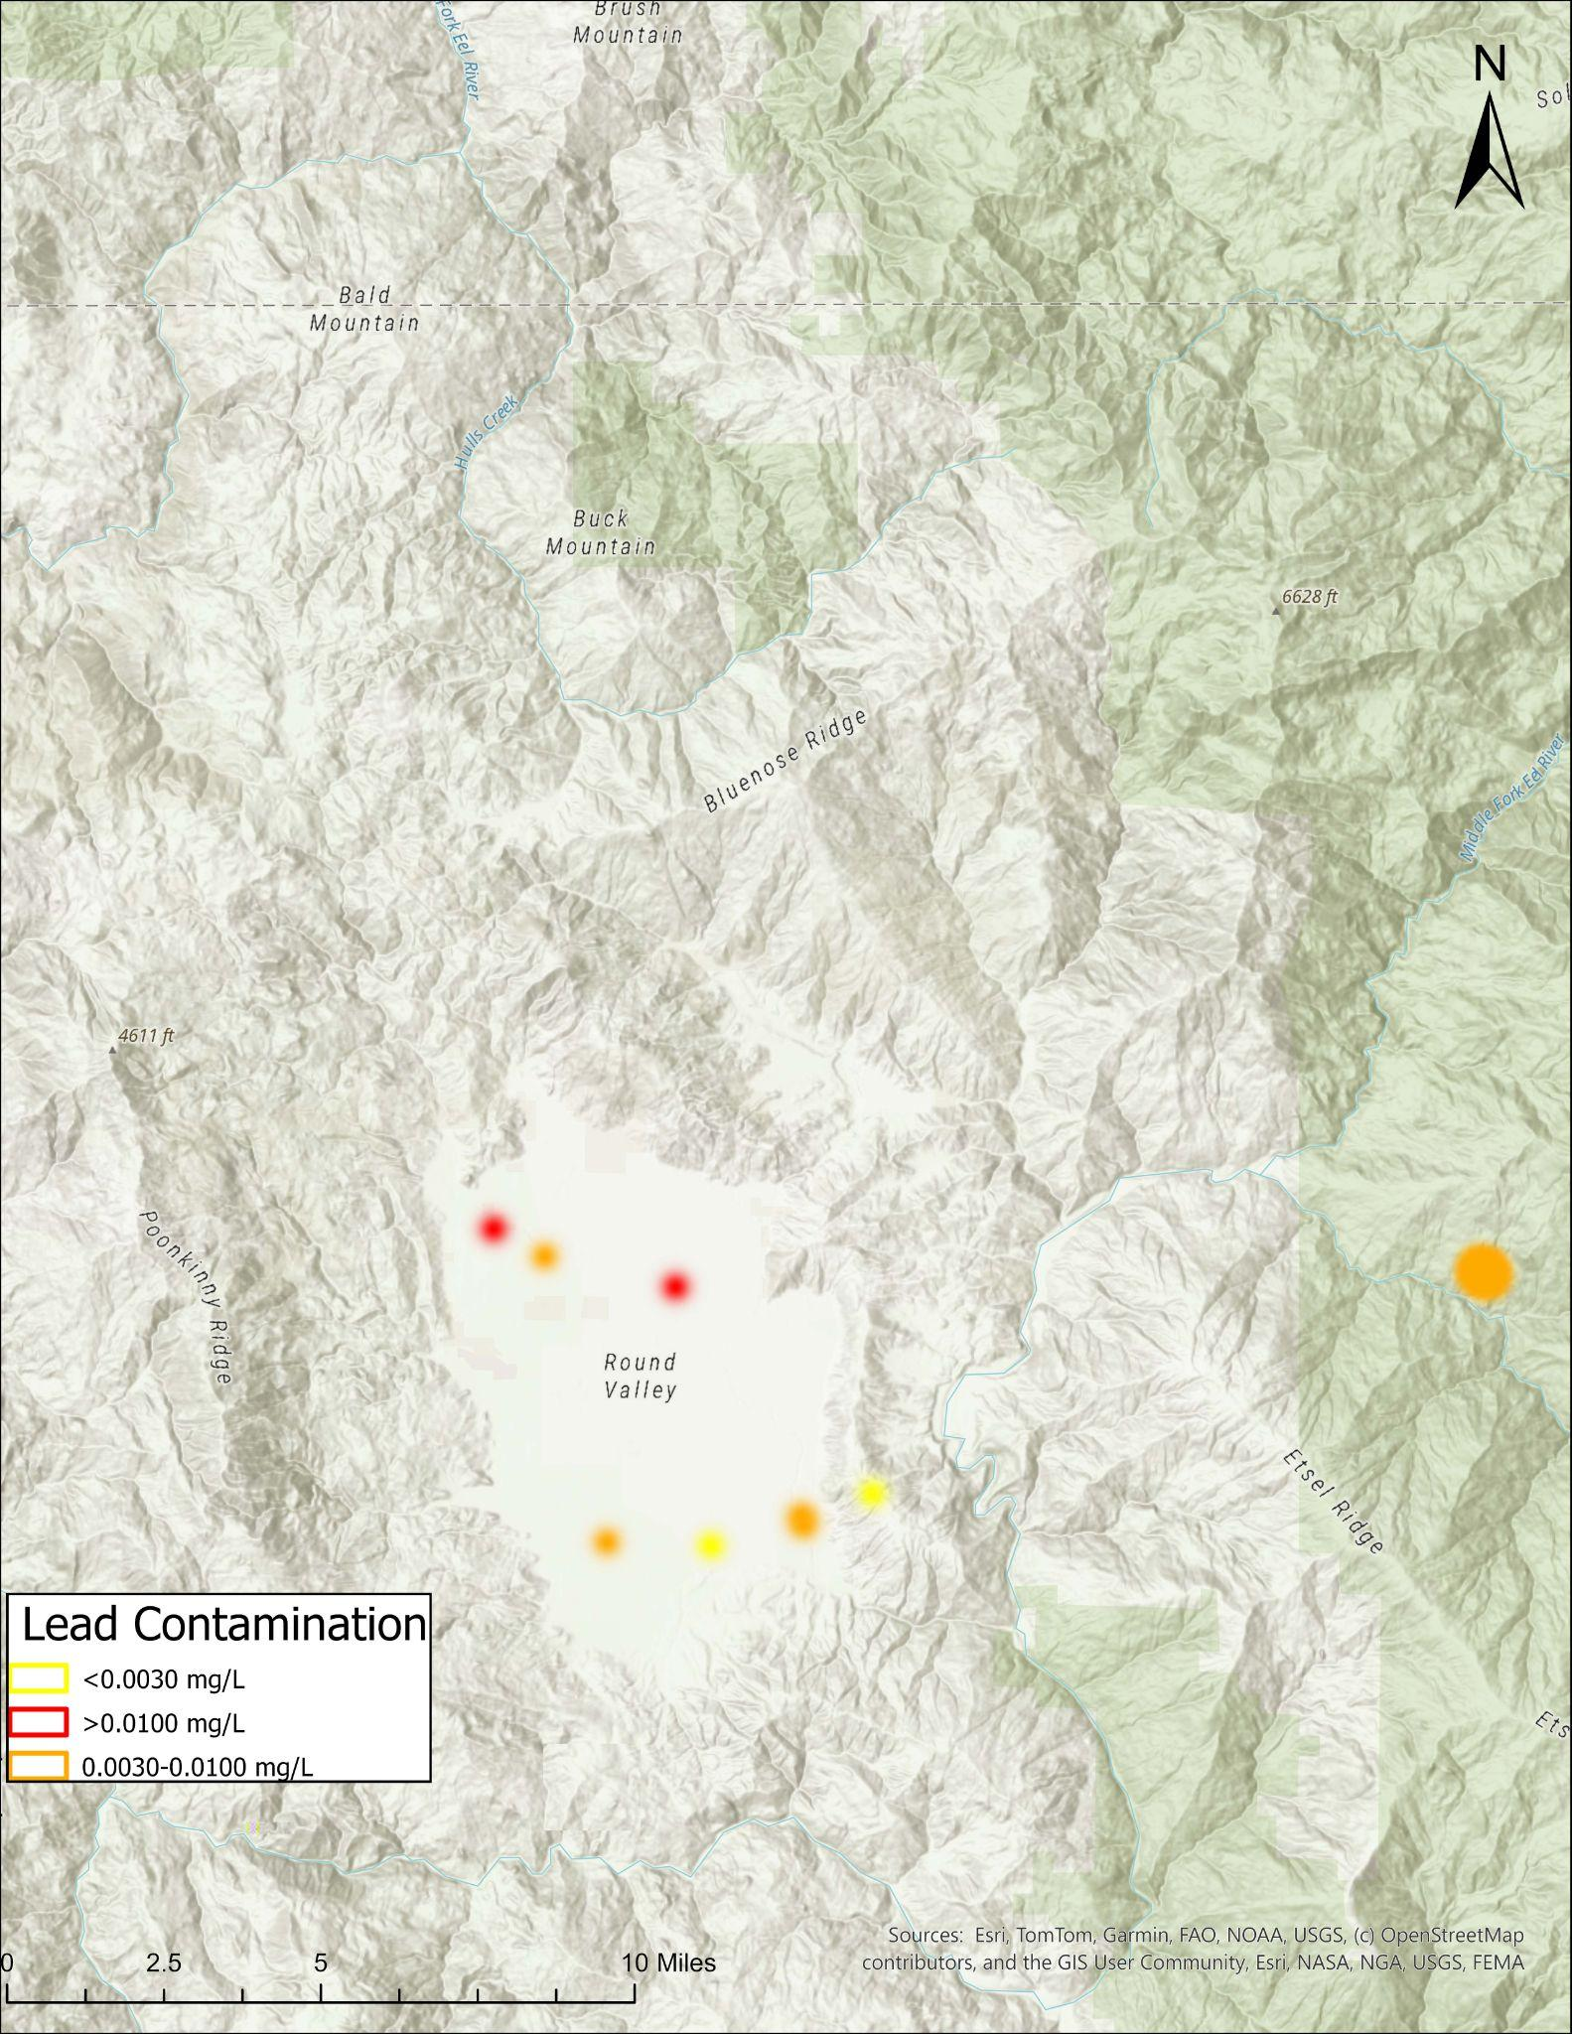
Lead
8/80 samples (10%) contained greater than 0.002 mg/L of lead
There is no EPA established unsafe level for lead because any amount of lead is considered unsafe
Lead levels ranged from .0022 mg/L to .089 mg/L

Slide 14
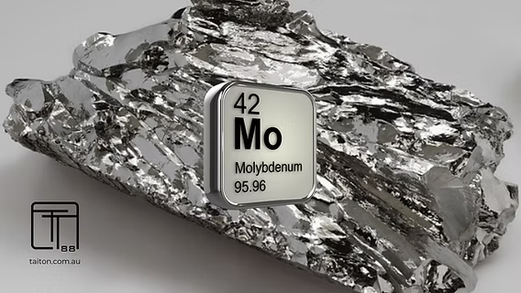
Molybdenum
28/80 samples (35%) contained greater than 0.002 mg/L of molybdenum
Of those 28, 0 had a molybdenum level above the EPA limit (.04 mg/L)
Molybdenum levels ranged from .0024 mg/L to .023 mg/L
Image from https://www.taiton.com.au

Slide 15
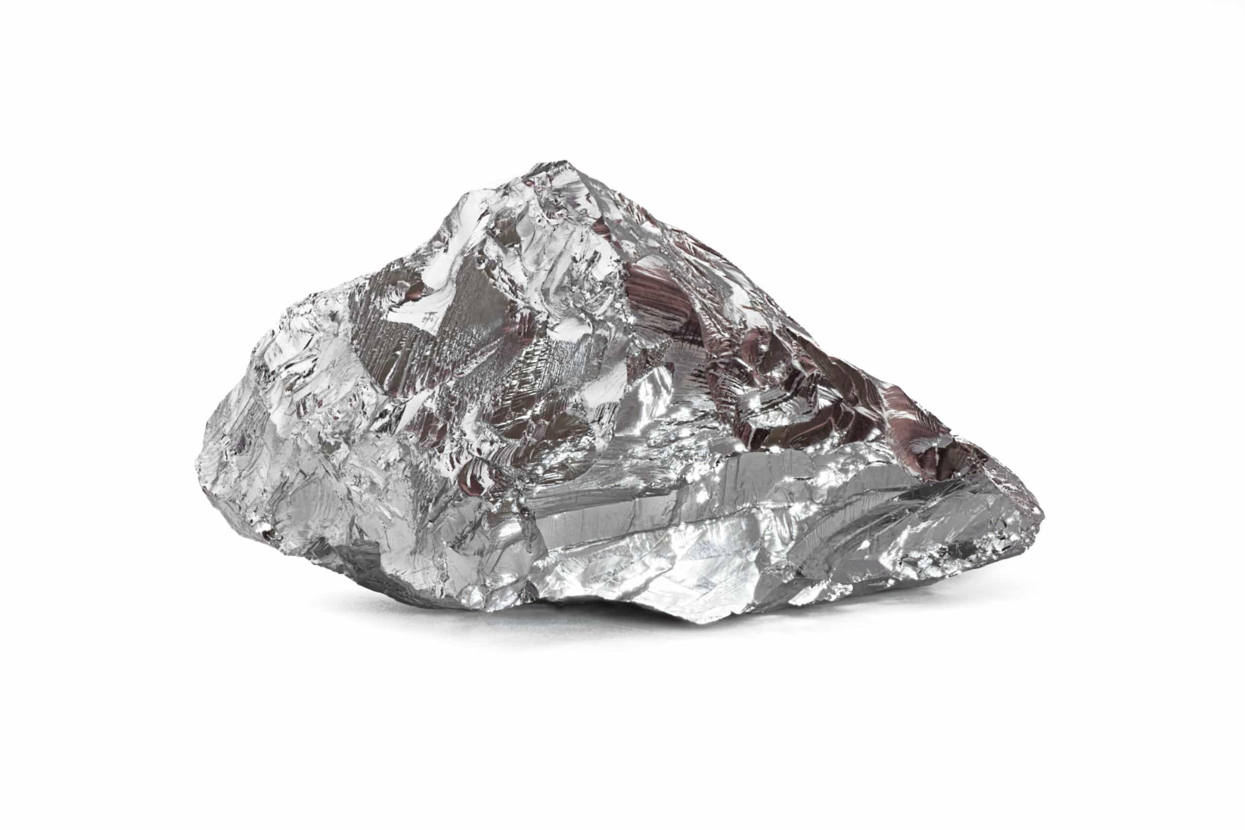
Nickel
27/80 samples (34%) contained greater than 0.002 mg/L of nickel
Of those 27, 0 had a nickel level above the EPA limit (.1 mg/L)
Nickel levels ranged from .002 mg/L to .059 mg/L
Image from https://www.cohenusa.com

Slide 16
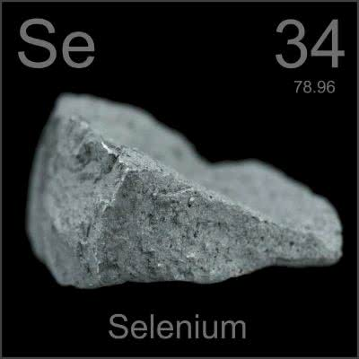
Selenium
8/80 samples (10%) contained greater than 0.002 mg/L of selenium
Of those 8, 0 had a selenium level above the EPA limit (2 mg/L)
Selenium levels ranged from .002 mg/L to .0042 mg/L
Image from https://lingolandedu.com

Slide 17
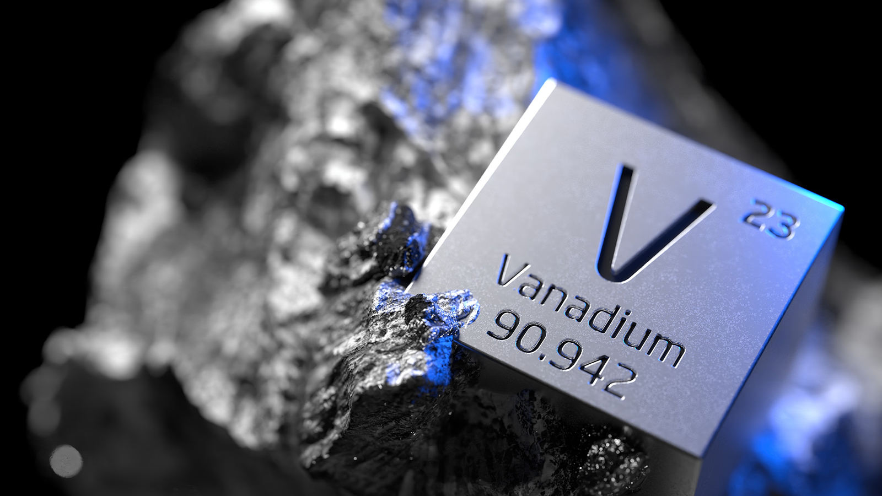
Vanadium
7/80 samples (9%) contained greater than 0.002 mg/L of vanadium.
Of those 7, 0 had a vanadium level above the EPA limit (2 mg/L).
Vanadium levels ranged from .002 mg/L to .007 mg/L.
Image from https://www.batterytechonline.com

Slide 18
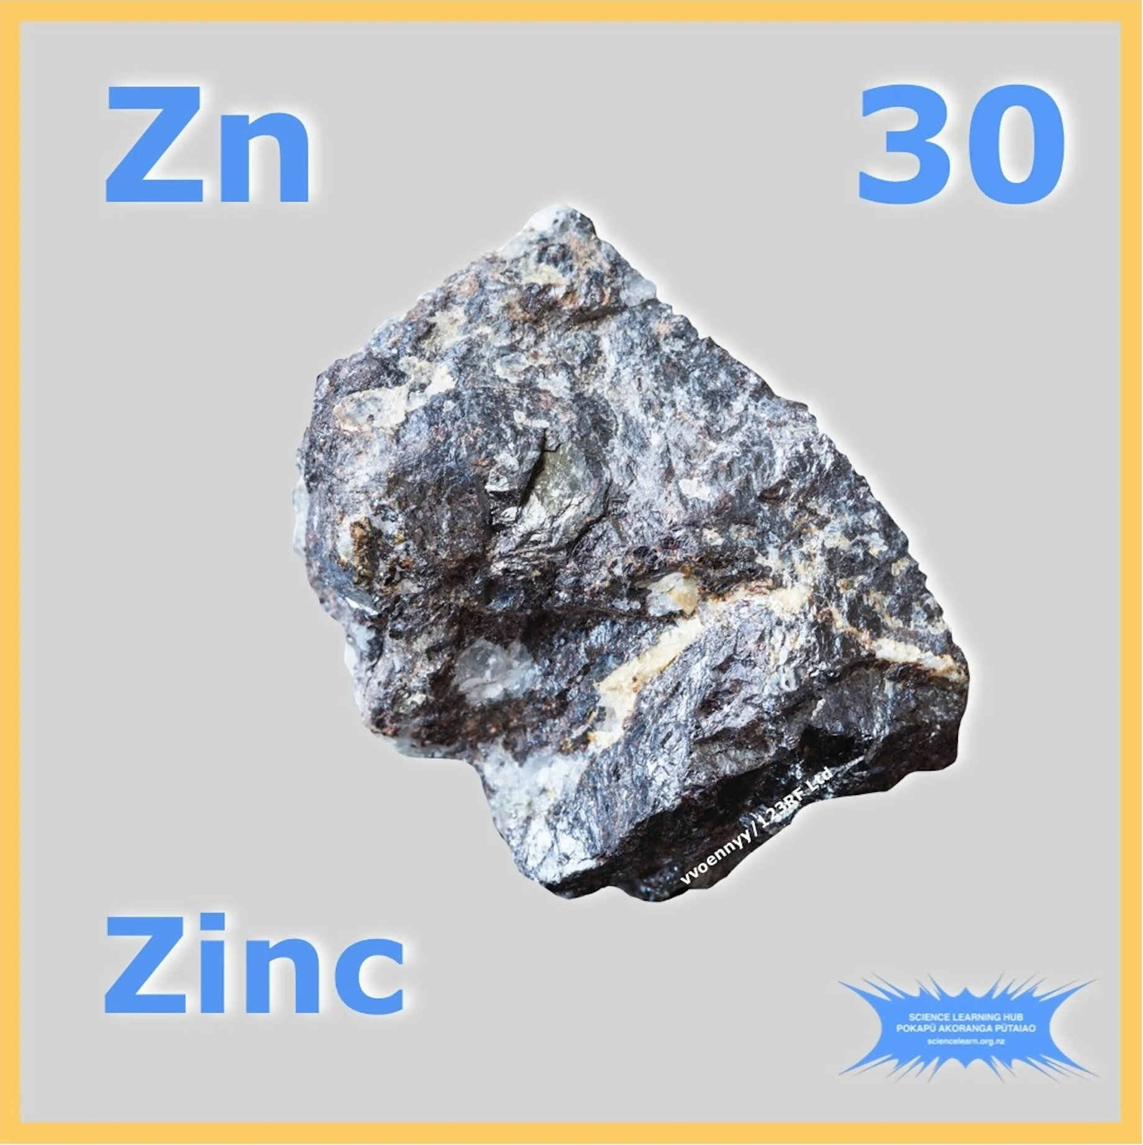
Zinc
47/80 samples (59%) contained greater than 0.01 mg/L of zinc.
Of those 47, 0 had a zinc level above the EPA limit (5 mg/L).
Zinc levels ranged from .011 mg/L to 1.5 mg/L.
Image from https://www.sciencelearn.org.nz

Slide 19
Next Steps

